Slide 1
Theory Validation
Dirk Riehle, Univ. Erlangen
NYT C09
Licensed under CC BY 4.0 International

Slide 2
In-, De-, and Reduction
Induction is the
Act of inserting ducks into science
Deduction is the
Act of removing ducks from science
Reduction is the
Act of replacing worn out ducks in science

Slide 3
Agenda
Theory validation
Research hypotheses
Example methods
Hypothesis testing
Quality assurance

Slide 4
1. Theory Validation

Slide 5
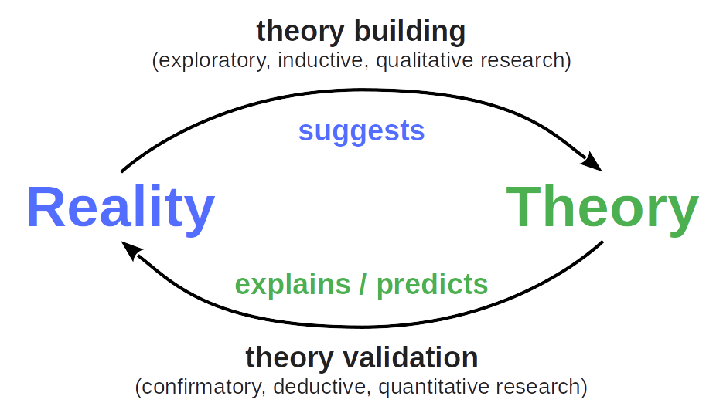
The Process of Science (Recap)

Slide 6
Purpose of Theory Validation
The purpose of scientific theory validation is to
Discriminately and adversarially test a theory
To identify weaknesses and holes
In a cost-efficient way

Slide 7
What Can Be Learned?
Validation(ism) (verificationism)
The belief that you can proof (“validate”) a theory
Closely aligned with classic positivist stance
Falsification(ism)
The belief that you can't proof a theory correct
But that you should keep it around until it got falsified
Falsification dominates, yet a falsification may be incorrect

Slide 8
Theory Validation Research
Theory validation research is
Confirmatory
Deductive
Quantitative

Slide 9
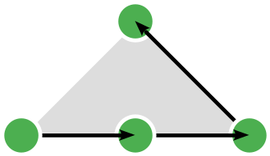
Deductive Reasoning
Deductive research is based on deductive reasoning (in research) which is
Generating hypotheses from theory for purposes of testing these

Slide 10
Theory Validation vs. Application
Use (application) of a theory is a form of hypothesis generation
In theory validation, we
Adversarially seek out boundary cases to
Test the theory
In theory application, we
Make sure we stay within the sweet spot to
Build something of use

Slide 11
Quantitative Research Methods
A quantitative research method
Gathers quantitative data
Using sampling methods that allow for statistical generalization
To run a hypothesis test

Slide 12
What Makes a Research Design a Quantitative Design?
The theory validation purpose
The use of random sampling in data collection
The acquisition and use of quantitative data

Slide 13
The Theory Validation Process
The theory validation research process
Incremental (one hypothesis at a time)
Is never finished
The hypothesis testing process
Is often a one-shot process

Slide 14
2. Research Hypotheses

Slide 15
Hypotheses (Expanded)
A research hypothesis (recap) is a
Research question that can only be answered with yes or no, true or false
This binary nature is often turned into a quantified relationship
Variable A (the independent variable) influences the variable B (the dependent variable)
An independent variable is a
Variable taken as input, possibly purposeful varied as part of the test
A dependent variable is a
Variable that is measured in response to changes in the independent variable

Slide 16
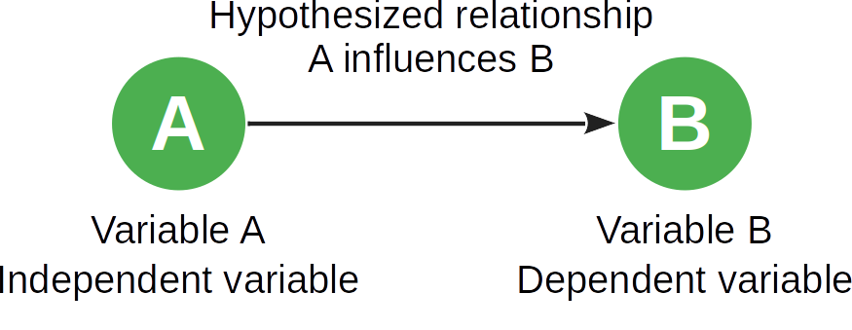
Hypothesis Testing

Slide 17
Theoretical Constructs
A construct is a
Human-made phenomenon
A theoretical construct is a
Non-tangible construct
A measurable construct is a variable

Slide 18
Example Theoretical Constructs
Usability of a website
Ability to write error-free code
Willingness to share information

Slide 19
Correlation and Causation
Variable A correlates with variable B if
Changes to variable A correspond to defined changes in variable B
Variable A causes variable B to change if
Changes to variable A cause defined changes in variable B
Correlation can be measured, causation needs to be established

Slide 20
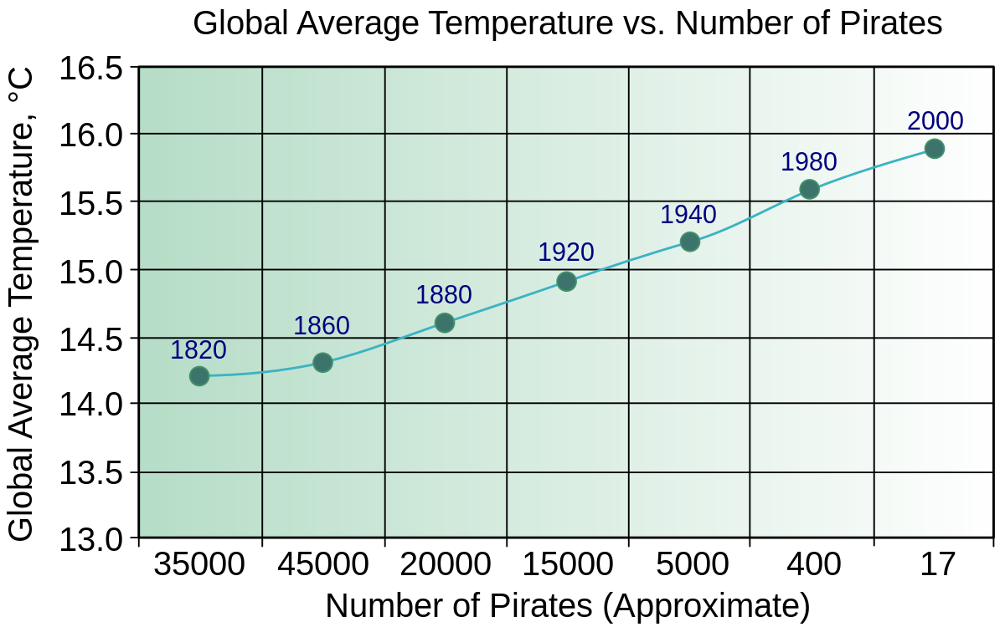
Causation vs. Correlation [1]
[1] See https://commons.wikimedia.org/wiki/File:PiratesVsTemp(en).svg

Slide 21
3. Example Methods

Slide 22
Common Quantitative Research Methods
Common quantitative research methods
Hypothesis-testing surveys
Controlled experiments
Noteworthy, but …
Confirmatory case studies
Post-facto analyses

Slide 23
Hypothesis-Testing Surveys
A hypothesis-testing survey is a
Quantitative investigation of one or more phenomena to test one or more hypotheses
Usually performed using a questionnaire on a large representative population
Having them answer in their natural (uncontrolled) environment
There are other types of surveys, e.g. descriptive surveys, which
May suggest interesting insights, are useful in theory building

Slide 24
Hypothesis-Testing Survey Research Process
Define goals
Identify constructs
Define hypotheses
Design survey
Identify or develop instruments
Design questionnaire
Determine sample
Define or identify population
Choose sampling strategy
Sample from population
Beta-test survey
Execute survey
Evaluate results

Slide 25
Controlled Experiments
A controlled experiment is a
Quantitative investigation one or more phenomena to test one or more hypotheses
Usually performed by providing treatments to small samples
In a tightly controlled environment
There are other types of experiments, e.g. quasi experiments, which
May suggest interesting insights, are useful in theory building

Slide 26
Controlled Experiments Research Process
Define goals
Identify constructs
Define hypotheses
Design experiment
Identify variables
Design treatments
Determine treatment groups
Define or identify population
Perform random sampling
Assign to treatment groups
Perform experiment
Perform treatments
Measure variables
Evaluate results

Slide 27
Hypothesis-Testing Survey vs. Controlled Experiment
 | Hypothesis-Testing Survey | Controlled Experiment
Size of sample | (Usually) large | (Usually) small
Dealing with variation | Through large sample size | By controlling the environment
Data collection | Questionnaire | Observation

Slide 28
4. Hypothesis Testing

Slide 29
Construct Operationalization
Two approaches to defining a construct
Intrinsic definition
The definition is based the construct’s assumed intrinsic properties
Then, there can be different ways of measuring the construct
Extrinsic definition
The construct’s operationalization is its definition
Then, there is is exactly one way of measuring the construct
Two discussion examples
Economic value of a public company
Societal value of a non-profit organization

Slide 30
Measurement Instruments
A measurement instrument
Measures a (theoretical) construct / variable
Examples for tangible constructs
Clock for measuring speed
Thermometer for measuring heat
Particle counter for measuring pollution
Examples for non-tangible (theoretical) constructs
Checker / linter for measuring source code quality
Question set for measuring intention to share knowledge
Market capitalization for measuring a company’s economic value

Slide 31
Construct Validity
Construct validity is the extent to which a
A construct’s operationalization matches the construct’s intrinsic definition
Easy if the operationalization defines the construct

Slide 32
Sampling Model (Recap)
A sampling model
Is a model of the population designed to sample from
Focuses on the variables of relevance to the research question

Slide 33
Sampling
The primary sampling strategy in testing hypotheses is random sampling
Random sampling is a
Sampling strategy in which elements of the population are chosen randomly
Stratified random sampling is a
Sampling strategy, in which the population is split into strata before random sampling
Random sampling is the strategy of choice
To avoid researcher and other biases

Slide 34
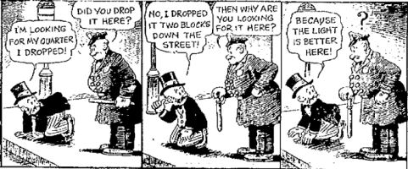
Convenience Sampling [1]
[1] See https://en.wikipedia.org/wiki/Streetlight_effect

Slide 35
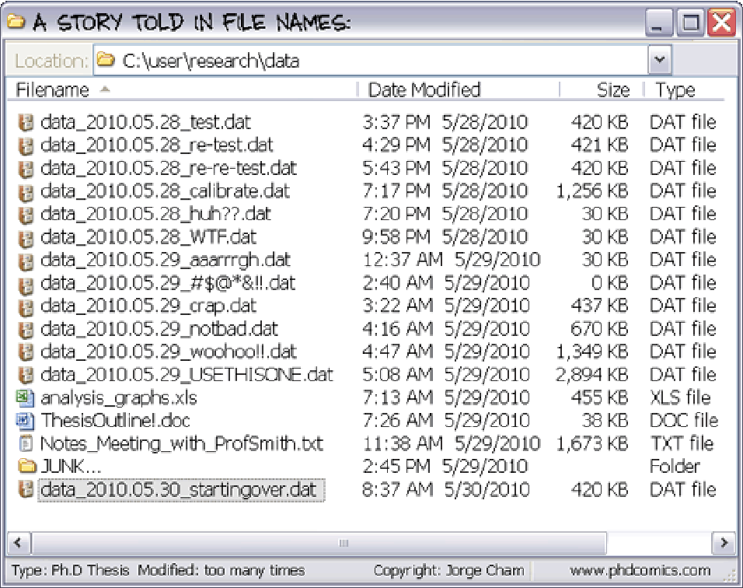
Fishing for results [1]
[1] See https://phdcomics.com/

Slide 36
5. Quality Assurance

Slide 37
Quality Criteria for Research Methods (Recap)
Intuition | Qualitative research | Quantitative research
Truth value | Credibility | Internal validity
Applicability | Transferability | External validity
Consistency | Dependability | Reliability
Neutrality | Confirmability | Objectivity

Slide 38
Traditional Empirical Criteria
Internal validity is the extent to which the study result
Shows a cause and effect relationship
External validity is the extent to which the study result
Can be generalized beyond the study
Reliability is the extent to which the study result
Can be repeated under the same conditions
Objectivity is the extent to which the study result
Can be repeated by other researchers

Slide 39
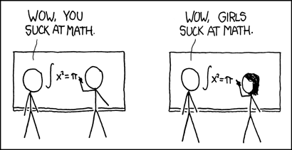
Inappropriate Generalization [1]
[1] See https://xkcd.com/385/

Slide 40
Summary
Theory validation
Research hypotheses
Example methods
Hypothesis testing
Quality assurance

Slide 41
Thank you! Any questions?
dirk.riehle@fau.de – https://oss.cs.fau.de
dirk@riehle.org – https://dirkriehle.com – @dirkriehle

Slide 42
Legal Notices
License
Licensed under the CC BY 4.0 International license
Copyright
© Copyright 2022 Dirk Riehle, some rights reserved

